Slide 1

LENDING CLUB
CREDIT RISK ANALYTICS
EXPLORATORY DATA ANALYSIS
Presented by
Saikrupa Purushothaman
p.Saikrupa@gmail.com

Slide 2
Our understanding of requirements
Consumer Finance Company specializing in lending various types of loans to urban consumers
Analyse risks in lending to a consumer using the data provided
Two types of associated risks
If the applicant is likely to repay, then not approving the loan will result in the loss to the company
If the applicant is not likely to repay (likely to default), approving the loan will lead to financial loss to the company
Loan data for the past years has been provided in the form of CSV files
Objective
Identify patterns that indicate if an applicant is likely to default
Understand driving factors behind loan defaults
Pattern identification will help the Consumer Finance Company to make decisions such as denying the loan application, lending at interest rate, reducing the loan amount etc

Slide 3
Data
Past loan data provided for the years 2007-2011
Data includes only Current (ongoing loans), Fully Paid loans and Charged Off loan details
Rejected Loan details not provided
Additional details related to loans and borrower attributes are available for analysis

Slide 4





High Level Approach
Data Cleaning
Univariate Analysis
Bivariate Analysis
Multivariate Analysis
Recommendation

Slide 5
Data Cleaning for Analysis

Slide 6
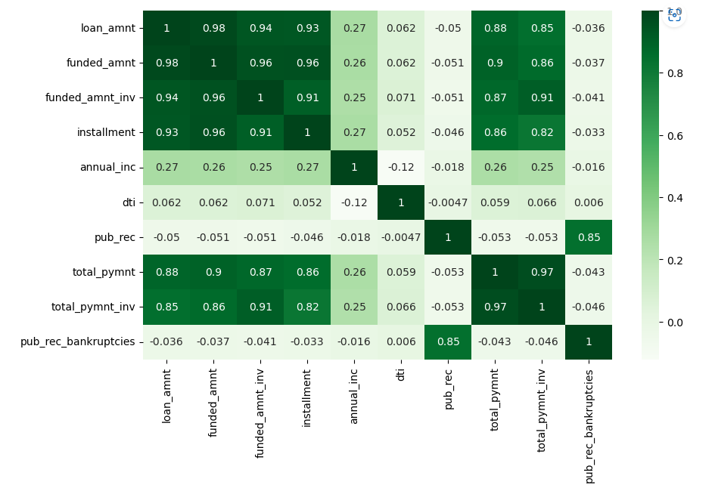
Data Cleaning for Analysis
Based on the correlation matrix, the following highly correlated columns were removed with an understanding that they may return similar results in analysis
funded_amnt, funded_amnt_inv and installment are highly corelated with loan_amnt
total_pymnt is highly corelated with total_pymnt_inv, loan_amnt
pub_rec_bankruptcies is highly correlated with pub_rec
Based on teh above explanation, the following columns will be removed
funded_amnt
funded_amnt_inv
installment
total_pymnt
total_pymnt_inv
pub_rec_bankruptcies

Slide 7
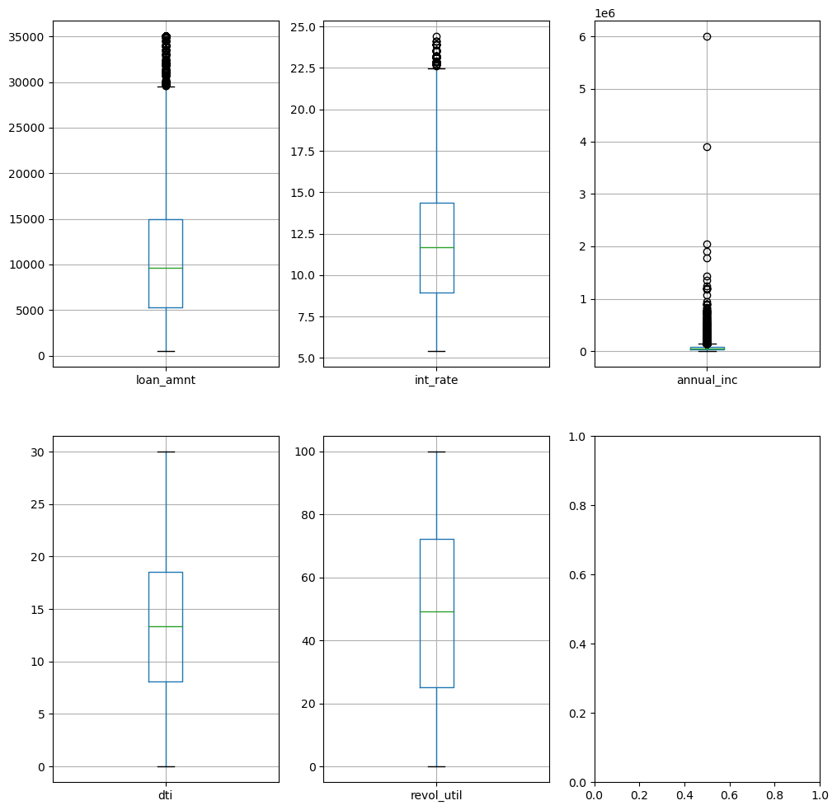
Outlier Removal
Outliers can be seen in loan_amnt, int_rate and annual_inc columns.
Outliers were removed for annual_inc and loan_amnt columns at 90th percentile
Outliers were not removed for int_rate column to not reduce the original row size significantly

Slide 8
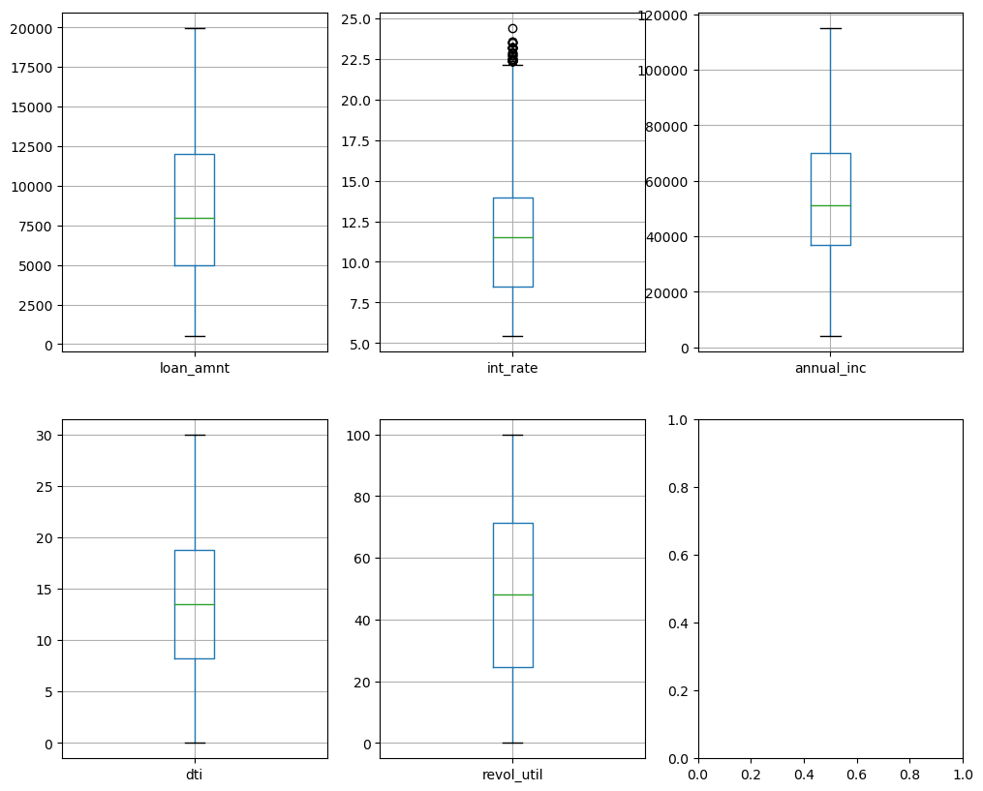
Outlier Removal
Post removal of Outliers
in
loan_amnt
annual_inc

Slide 9
Univariate Analysis
The following was done as part of Univariate Analysis
Understand the split between fully paid and charged off (default) loans
Explore Charged Off (defaulters) data across various category and continuous variables

Slide 10
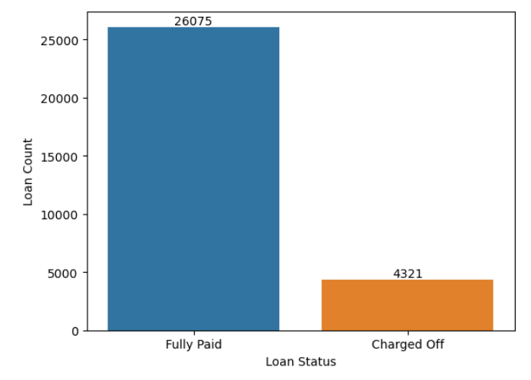
Univariate Analysis
~ 17% of the overall loans are being Charged Off and are considered as Default loans

Slide 11
Univariate Analysis

Slide 12
Univariate Analysis
Considering that the objective of the exercise is to identify patterns in default loan data, the univariate analysis is aimed at the “Default Loan” subset
This subset is derived filtering the loan_status column in the dataset to “Charged Off”
Univariate Analysis was done on the following categorical and continuous variables
Unordered Categorical Variables
Ordered Categorical Variables
Continuous Variables
term
home_ownership
purpose
verification_status
grade
emp_length (work experience)
ssue_yearmonth
loan_amnt
int_rate
annual_inc
dti
revol_util

Slide 13
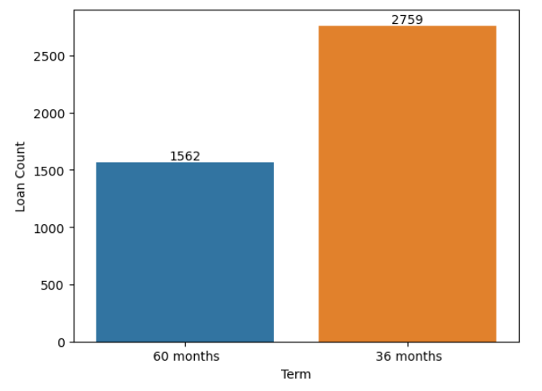
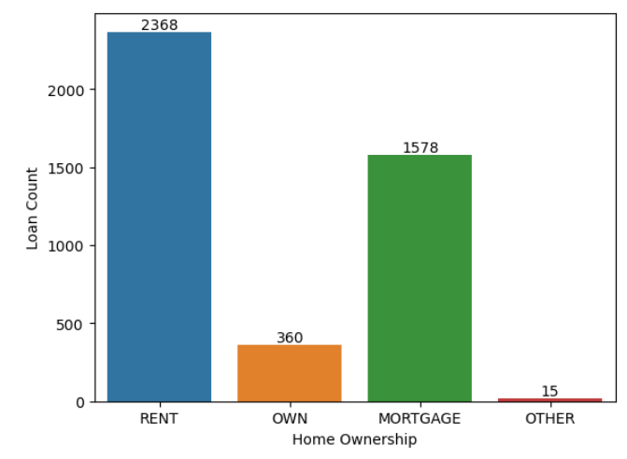

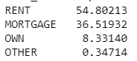
Univariate Analysis – Category Variables
Count & % split by term
Count & % split by home_ownership
Borrowers whose repayment term is shorter (36 months) default more than the ones with longer repayment term.
Percentage of borrowers who have own home and fail to pay the loan is much lesser than the percentage of borrowers who are either on rent or mortgage

Slide 14
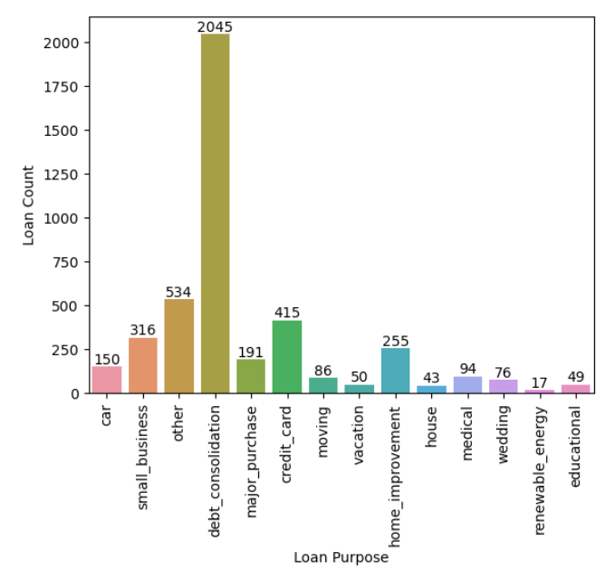
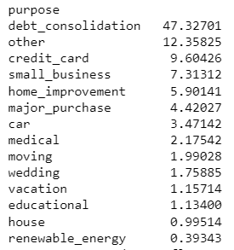
Univariate Analysis – Category Variables
Count & % split by Purpose of the loan
About ~47% of the borrowers who borrow for the purpose of consolidating debts have defaulted.

Slide 15
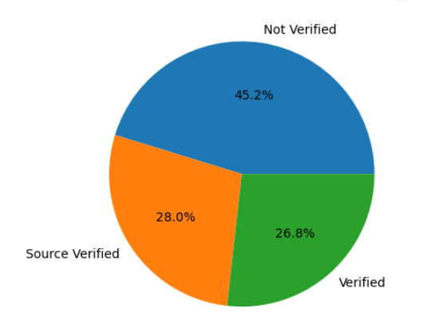
Univariate Analysis – Category Variables
% split by Income Verification Status
~43% of borrowers whose income was not verified had defaulted

Slide 16
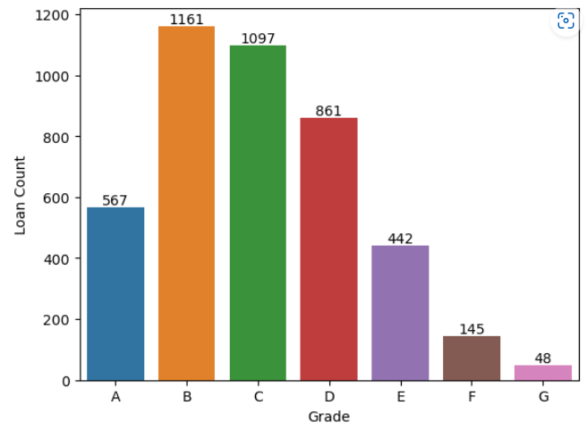
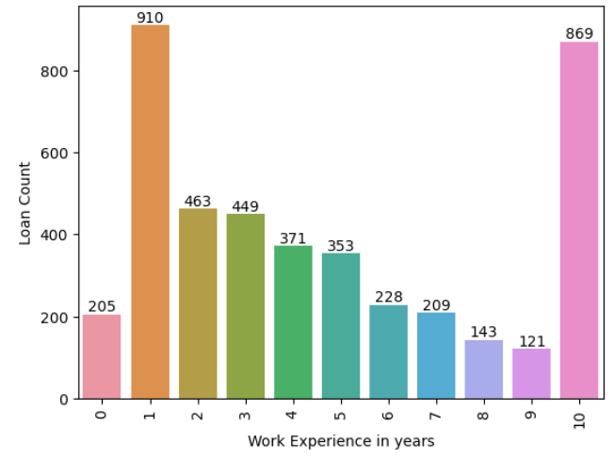
Univariate Analysis – Category Variables
Count by Grade
Count by by work experience years
Categories B, C and D are the top categories which has more number of loan defaulters
Borrowers with 0-1 year of experience and > 10 years of experience are the major defaulters

Slide 17
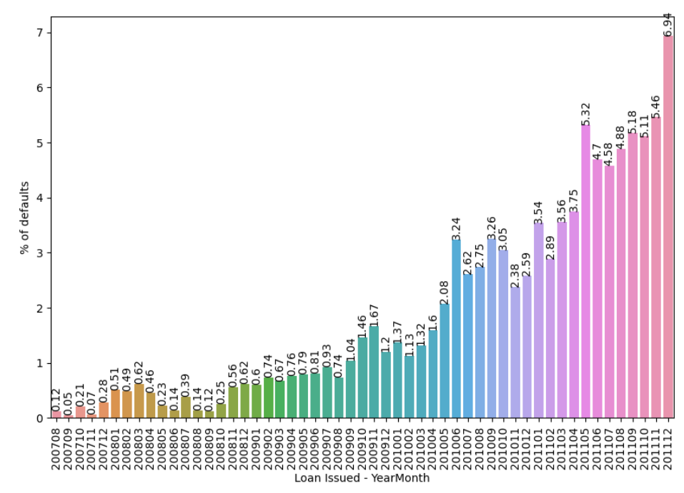
Univariate Analysis – Category Variables
Count by Issue Year Month
The percentage of defaults have steadily increased over time

Slide 18
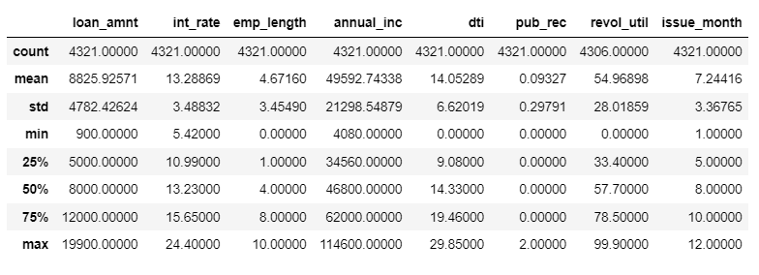
Univariate Analysis – Continuous Variables
Summary Metrics

Slide 19
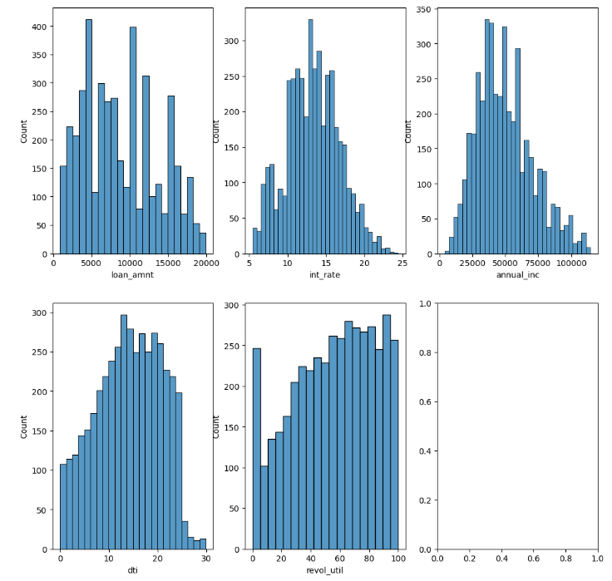
Univariate Analysis – Continuous Variables
Understanding the distribution of continuous variables

Slide 20
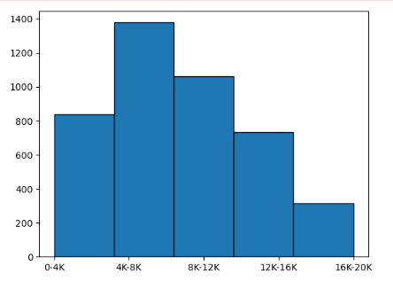

Segmented Univariate Analysis
Analyse Loan Amount by binning
Analyse Debt to Income ratio by binning
Most defaults are in the range of 4K-8K and 8K-12K loan amounts
The Debt to Income ratio of 11-20 has the highest number of defaults

Slide 21
Bivariate Analysis

Slide 22
Bivariate Analysis
Bivariate Analysis was done on the overall data to understand how 2 or more variables compare
Following analysis were done
Analyse how interest rates vary by purpose
Analyse the percentage of default loan amount across various categorical variables liks grade, home ownership etc
Analyse how Debt to Income indicator compare to default loan amounts

Slide 23
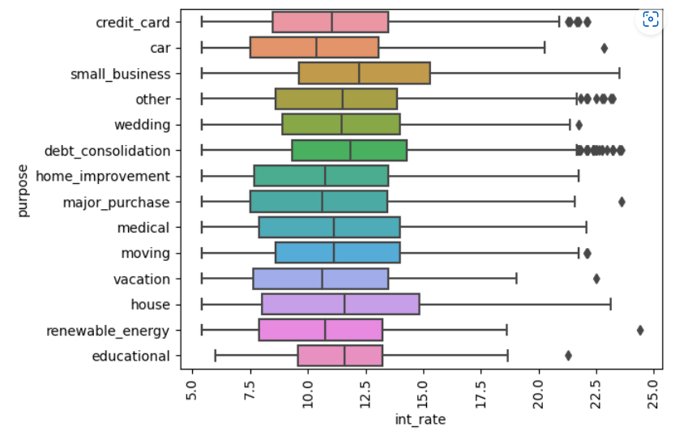
Bivariate Analysis
Analysing Purpose and Interest Rate using summary metrics
Interest rates are higher for small business, house, debt_consolidation

Slide 24
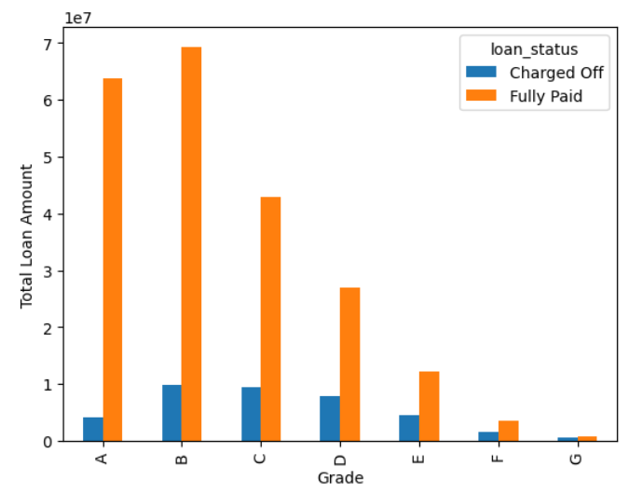
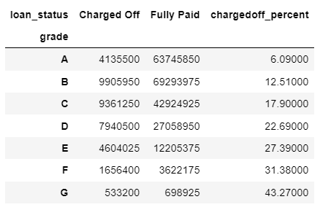
Bivariate Analysis
Analyse charged off loan amount as a propotion of total loan amount by Grade
Grades G, F and E have the highest percentage of Charged Off loans

Slide 25
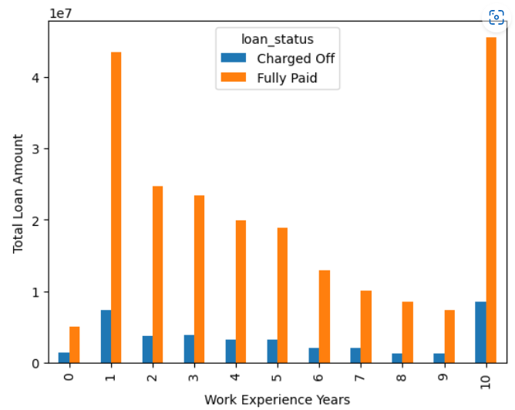
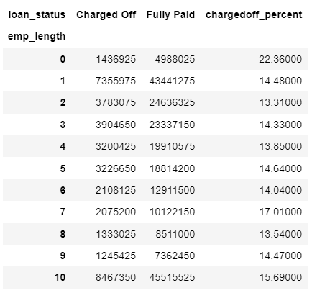
Bivariate Analysis
Analyse charged off loan amount as a propotion of total loan amount by Work Experience
Higher percentage of defaulters are in the work experience range of 0-1 years or 10+ years

Slide 26
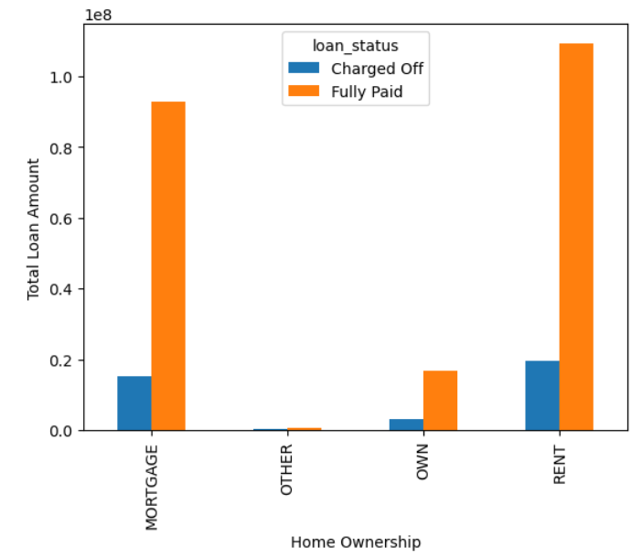
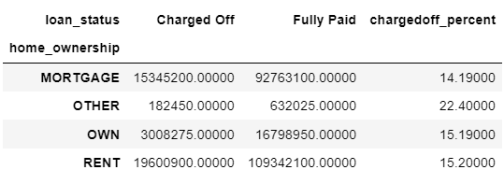
Bivariate Analysis
Analyse charged off loan amount as a propotion of total loan amount by Home Ownership
Though the overall loan amount against “Other” is small, the percentage of default loan amount is higher.
For other categories like Own, Rent and Mortgage, the % of default loan is similar.

Slide 27
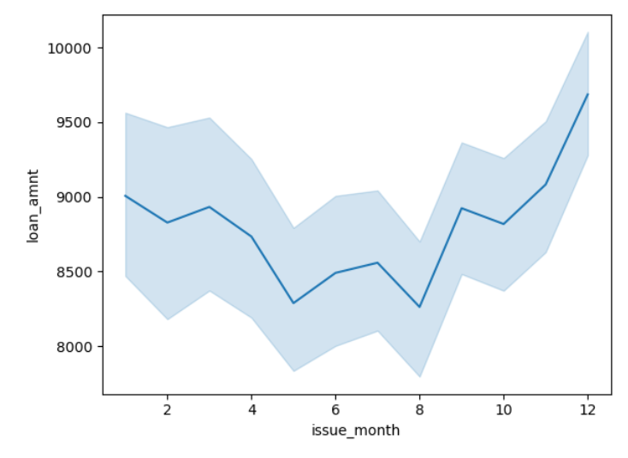
Bivariate Analysis
Analyse the relationship between default loan amount and issue months
Defaults on high on loan amounts that were issued in the month of January and December across the years

Slide 28
Multivariate Analysis

Slide 29
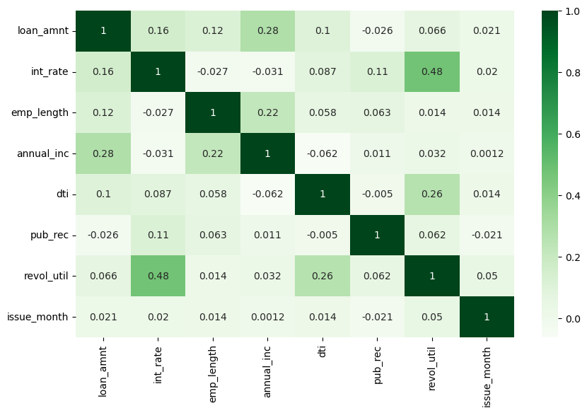
Multivariate Analysis
Correlation Matrix of continuous variables
No strong correlation between any two variables. Interest Rate and Revolving Line Utilization Rate are positively correlated.

Slide 30
Recommendations

Slide 31
Recommendations
Major Driving Factors for loan defaults
Home Ownership – Borrowers whose home ownership values are rent or mortgage have a higher risk of defaulting loans.
Purpose – If the purpose of the loan is debt consolidation, there is a higher probability of defaulting loans
Income Verification – If the income is not verified, higher the risk of default
Work Experience – Borrowers with work experience range between 0-1 and 10+ years have had a higher default loan amount value.
Issue Month – Loans issued during the months of December, January have higher default loan amounts.
Loan Amounts – Borrowers who took loans for amounts in the range of 4K-12K have defaulted more.

Slide 32
Recommendations
Major Driving Factors for loan sanctions
Interest Rate & Purpose – In the past, higher interest loans had been sanctioned for purposes like small business, house, debt consolidation. The Finance company can look at loan applicants for these purposes for higher interest rates and hence higher income.
Grade – Applicants from Grade A have less defaulted loans. Company can look to sanction loans to applicants in Grade A

Slide 33
Thank you
Saikrupa Purushothaman
p.saikrupa@gmail.com

